Slide 1
AtlantOS contributions to OceanSITES:
Derived timeseries from Transport Mooring Arrays
Wilken-Jon von Appen
on behalf of Torsten Kanzow
Alfred Wegener Institute
Helmholtz Centre for Polar and Marine Research

Slide 2
Agenda:
OceanSITES should host AtlantOS TMA high level data
Practical implementation
How can OceanSITES support this?
What external support is necessary?
Direct access to data via external web site
What is Atlantos / TMA WP3.3 / What data?

Slide 3
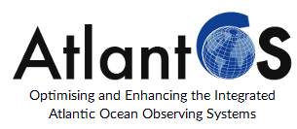
AtlantOS Workshop Task 3.3
New Orleans, Feb. 25, 2016
Torsten Kanzow
AtlantOS Task 3.3 core team: Torsten Kanzow (AWI), Johannes Karstensen (GEOMAR), Karin Margretha Larsen (HAV), Stuart Cunningham (SAMS), Gerard McCarthy (NOC), Sabrina Speich (CNRS), Markus Motz (Develogic)

Slide 4
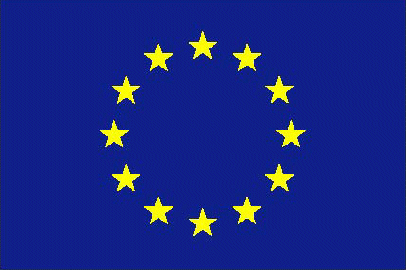
Schedule
12:30 - 12:35 Welcome - Torsten Kanzow (AWI)
12:35 - 12:45 The AtlantOS project - Johannes Karstensen (GEOMAR)
12:45 - 13:00 General aim of the "Transport mooring array" task within AtlantOS (including short discussion) - Torsten Kanzow
13:00 - 13:30 Presentation of first ideas for a joint transport mooring web site - Torsten Kanzow
13:30 - 14:00 Open discussion and definition of goals
18:30 - 19:30 Further discussion on specific issues

Slide 5
WP 3.3: Atlantic Transport mooring arrays
Components of AMOC transports at 26°N
Torsten Kanzow (AWI)
Johannes Karstensen (GEOMAR) Karin Margretha Larsen (HAV) Stuart Cunningham (SAMS)
Gerard McCarthy (NOC)
Sabrina Speich (CNRS)
Markus Motz (Develogic)
Smeed et al. (2014)
Within the Atlantic Observing System the great value of transport mooring arrays (TMA) is the acquisition of long time series of volume, heat and freshwater fluxes in key locations of strong flows (boundary currents), all of which are related to the Atlantic meridional overturning circulation. The overarching goal is the development of a sustainable, efficient and comprehensive network of TMAs, that is well-embedded into the Atlantic observing system.

Slide 6
Objective I: Create and present network overarching products and analyses
Deliverable : One stop shop web site for TMAs
preparations of setting up web site is ongoing
contributor workshop happened in February 2016 (Ocean Sciences Meeting)

Slide 7
OBJECTIVE II: Assess and enhance observational potential of the TMA network
The challenge is to conduct the research and innovation activities necessary to increase performance and efficiency of the observing system, building on existing capacities around the Atlantic and also to fill the observational gaps through the optimization of existing systems by better coordination, harmonization and integration and the use of new ocean observation technologies.
D3.18 Report on the observational potential of the Transport Monitoring Arrays and Synergies with the Wider Atlantic Observing System
1. Assessment of the impact of upper-ocean measurements;
2. Coherent integration of O₂ measurements (as example for non-physical EOVs) for transports and fluxes in the Atlantic TMAs;
One workshop will be held to prepare the report and foster the cooperation on cross-TMA analyses. PM45 (December, 2018).

Slide 8
Objective III: Extend the TMA network technological capabilities
Deliverable 3: Demonstrate the technical enhancement of a TMA site for data safety & cost efficiency, by implementation subsea real-time data telemetry systems

Slide 9
One stop shop web site for TMAs
„Inhomogeneity among the different TMAs challenges their sustainability“
We will make the individual and planned TMAs known to the scientific community, present the different TMAs conceptually and technically as one network, and freely provide documentation and higher level products

Slide 10
Long term observations need to work on acquiring continued funding
Visibility to science community and public
Scientific collaboration
Generate additional value
Similar discussion within ASOF (Arctic-Subarctic Ocean Fluxes)
Everyone is “sad” if a long time series has to be discontinued

Slide 11
Web site
Establishment of web site for TMAs where
the TMA network as a whole is introduced;
high-level TMA products can be obtained;
documentation of the products is provided;
links to data behind the high-level products (OceanSITES);
joint cross-TMA network analyses are provided.
team: Torsten Kanzow (AWI), Karin Margretha Larsen (HAV), Stuart Cunningham (SAMS), Sabrina Speich (CNRS)

Slide 12
Web site
represent the TMA network
rely on existing datasets
use peer-reviewed publications as documentation
provide graphs & higher level data products behind them
use OceanSITES format?
point to sensor data sets
keep web site alive beyond life of project

Slide 13
Ongoing / past initiatives
Rapid / Mocha
Naclim
US AMOC
....

Slide 14
Access to TMA high level data via (external) web site
What is possible
role for jcommobs??

Slide 15
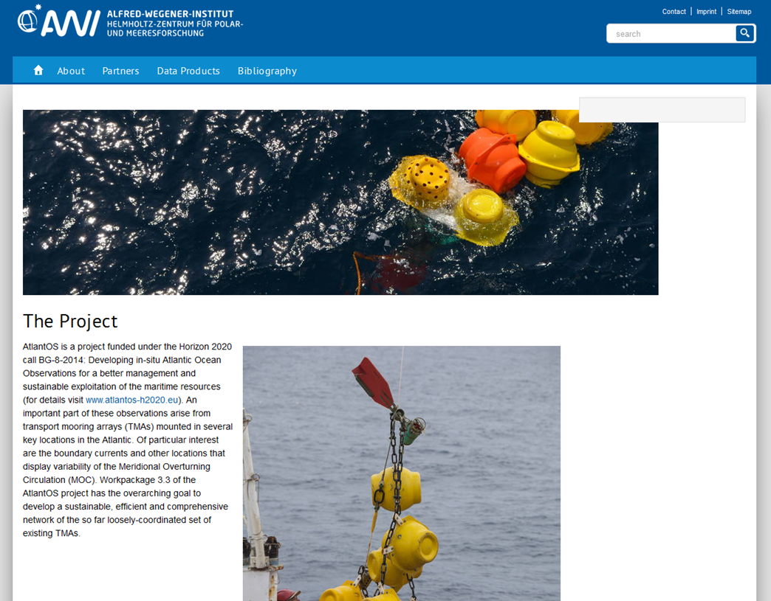
Website Task 3.3 – Home / About
http://www.atlantos-moorings.eu/

Slide 16
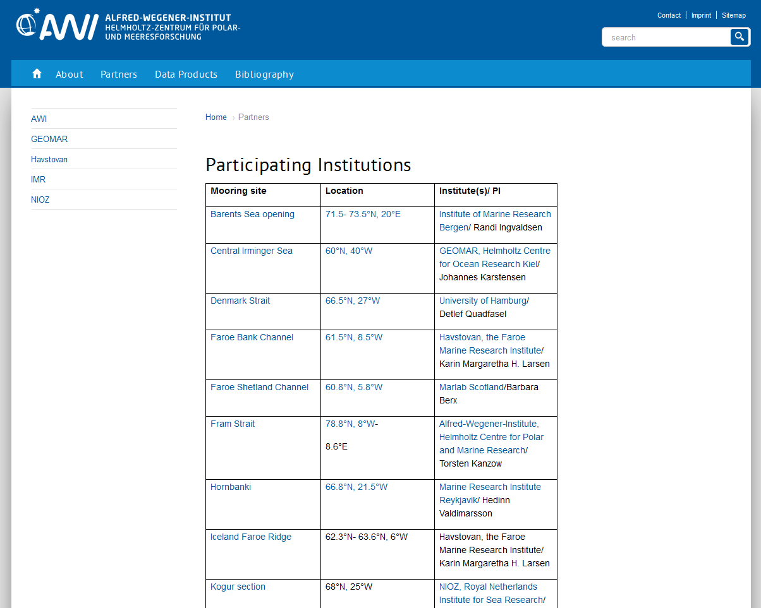
Website Task 3.3 - Partners
Link to google
earth
Link to
‚Data Products‘
Link to website
of institute

Slide 17
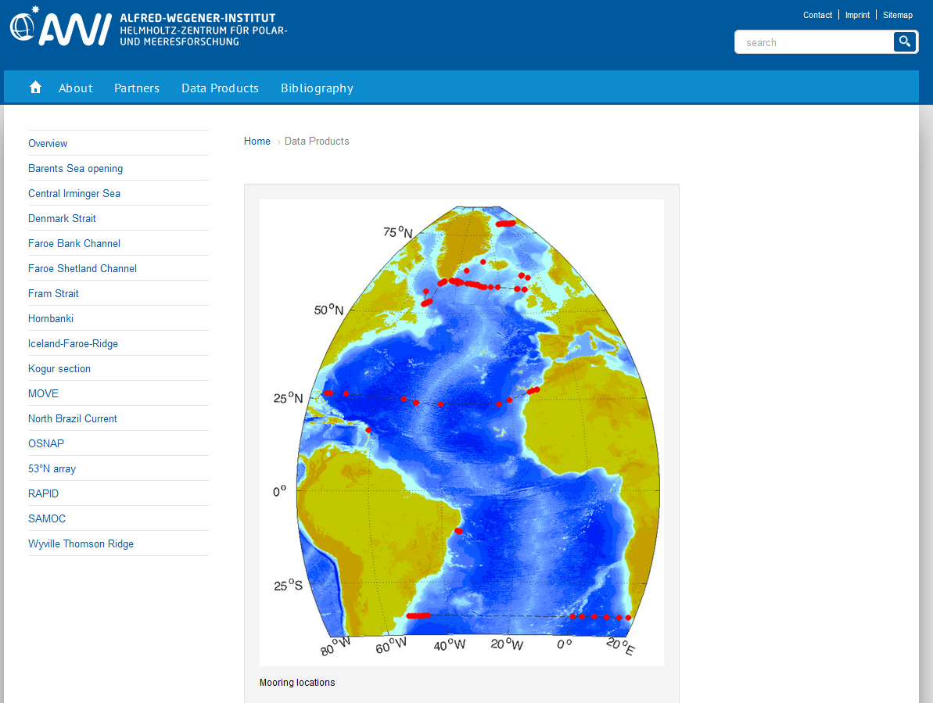
Website Task 3.3 – Data Products

Slide 18
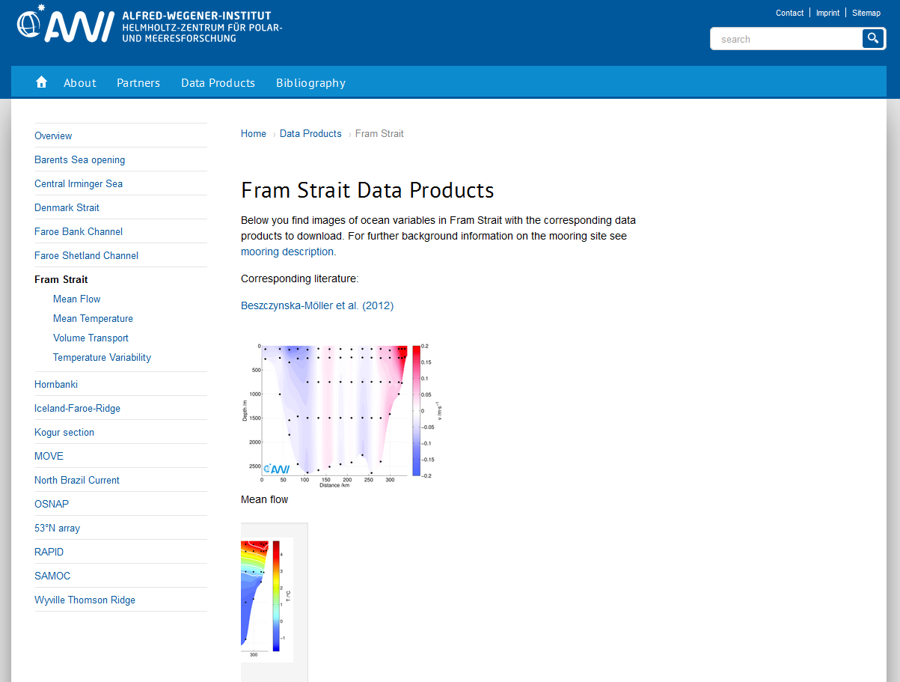
Website Task 3.3 – Data Products
Example
Fram Strait

Slide 19
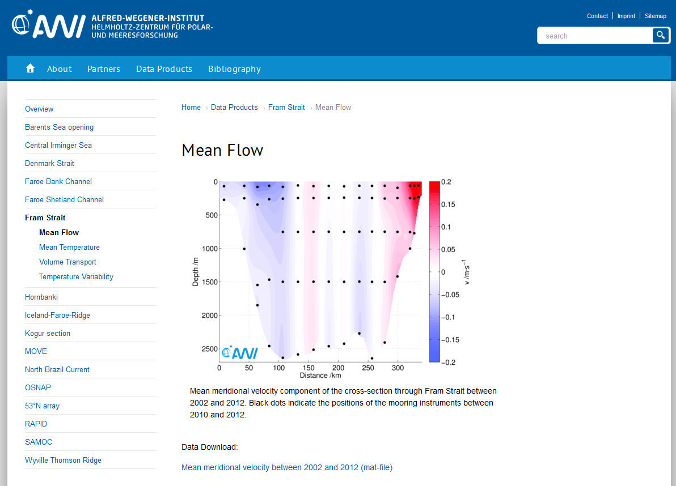
Website Task 3.3 – Data Products

Slide 20
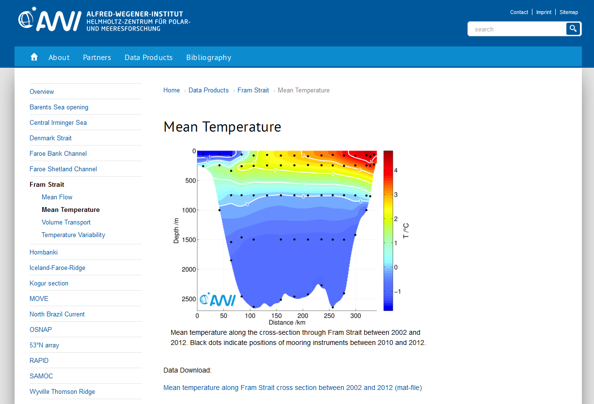
Website Task 3.3 – Data Products

Slide 21
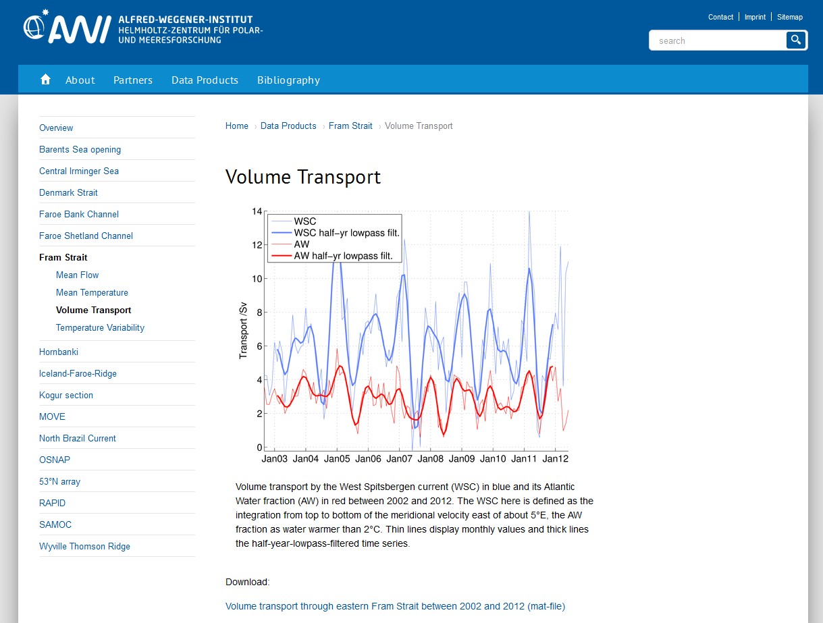
Website Task 3.3 – Data Products

Slide 22
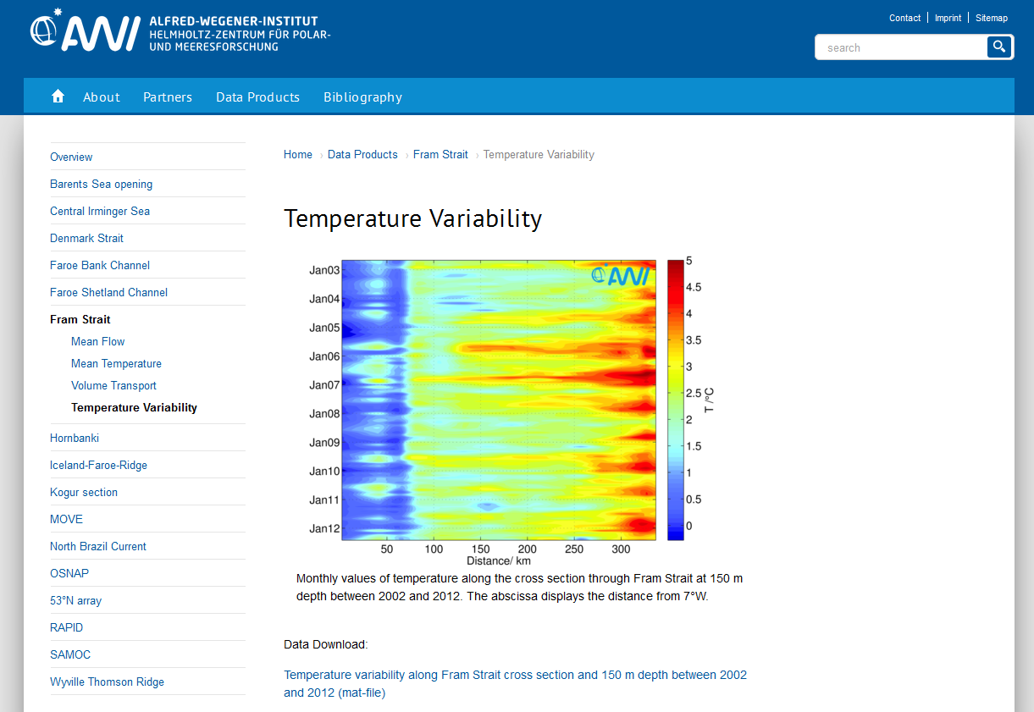
Website Task 3.3 – Data Products

Slide 23
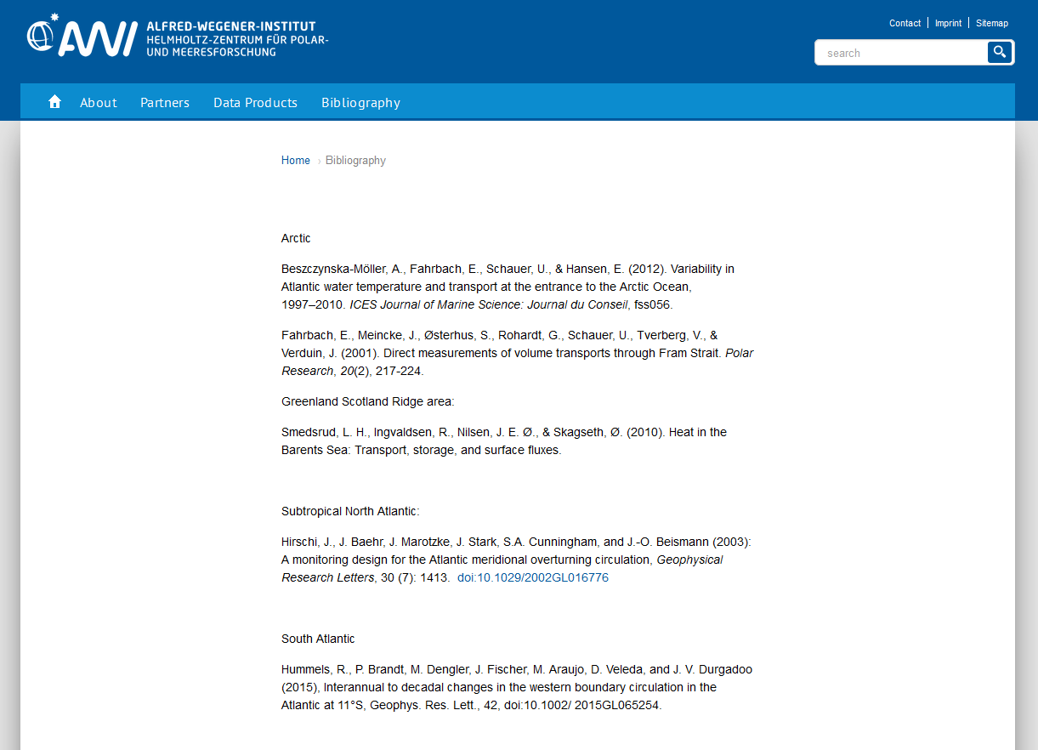
Website Task 3.3 - Bibliography

Slide 24
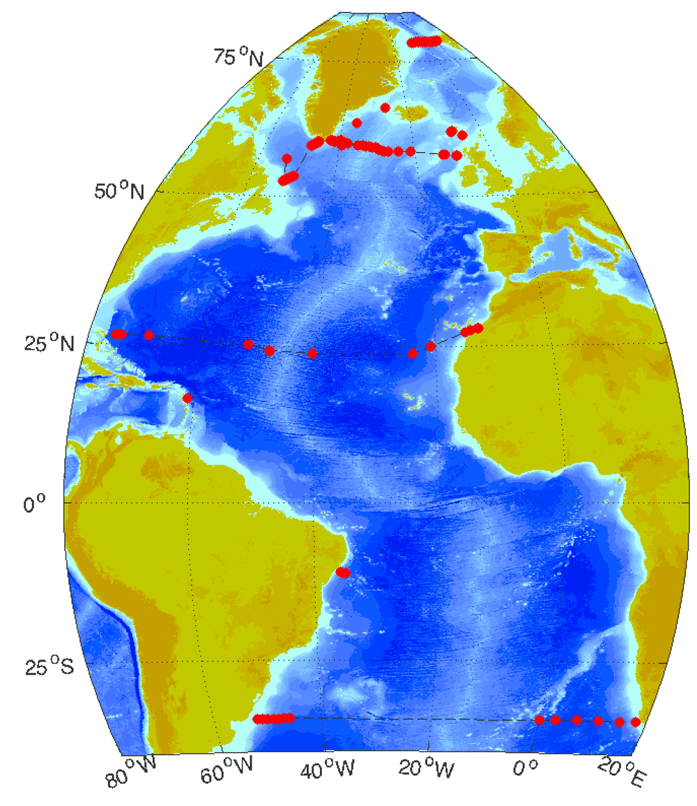
Locations of current/possible partners
Detailed input available from 10 locations:
RACE TropAT
RAPID
SAM – Southwest Atlantic MOC
NOAC – North Atlantic Changes – Array
SAMBA – South Atlantic MOCS Basin-wide Array
53°N Array
Faroe Bank Channel Overflow (FBC-overflow)
Iceland-Faroe Atlantic water inflow (IF-inflow)
OSNAP
FRAM

Slide 25
Potential Partners
Mooring site Location Institute(s)/ PI
Barents Sea opening 71.5- 73.5°N, 20°E Institute of Marine Research Bergen/ Randi Ingvaldsen
Central Irminger Sea 60°N, 40°W GEOMAR, Helmholtz Centre for Ocean Research Kiel/ Johannes Karstensen
Denmark Strait 66.5°N, 27°W University of Hamburg/ Detlef Quadfasel
Faroe Bank Channel 61.5°N, 8.5°W Havstovan, the Faroe Marine Research Institute/ Karin Margaretha H. Larsen
Faroe Shetland Channel 60.8°N, 5.8°W Marlab Scotland/Barbara Berx
Fram Strait 78.8°N, 8°W-
8.6°E Alfred-Wegener-Institute, Helmholtz Centre for Polar and Marine Research/ Torsten Kanzow
Hornbanki 66.8°N, 21.5°W Marine Research Institute Reykjavik/ Hedinn Valdimarsson
Iceland Faroe Ridge 62.3°N- 63.6°N, 6°W Havstovan, the Faroe Marine Research Institute/ Karin Margaretha H. Larsen
Kogur section 68°N, 25°W NIOZ, Royal Netherlands Institute for Sea Research/ Laura de Steur
MOVE 17°N, 60°W SCRIPPS Institution of Oceanography/ Uwe Send
North Brazil Current 11°S, 35.5°W GEOMAR, Helmholtz Centre for Ocean Research Kiel/ Peter Brandt
OSNAP The Scottish Association for Marine Science/ Stuart Cunningham; IFREMER/ Herle Mercier
RAPID 26.5°N, 75 -12°W National Oceanography Centre
SAMOC 35°S CNRS/ Sabrina Speich
Wyville Thomson Ridge 60°N, 9°W The Scottish Association for Marine Science/ Toby Sherwin
53°N 53°N, 51- 50°W GEOMAR, Helmholtz Centre for Ocean Research Kiel/ Johannes Karstensen

Slide 26
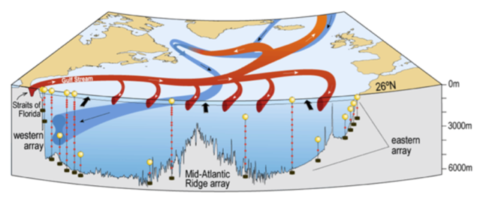
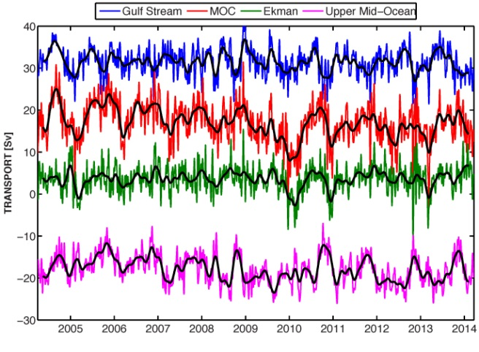
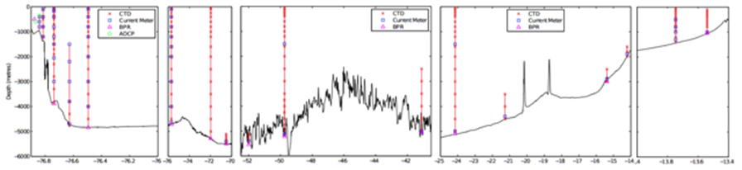
RAPID

Slide 27
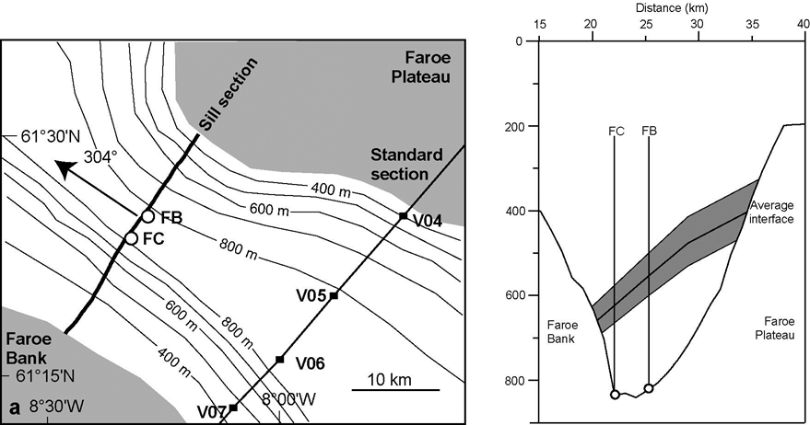
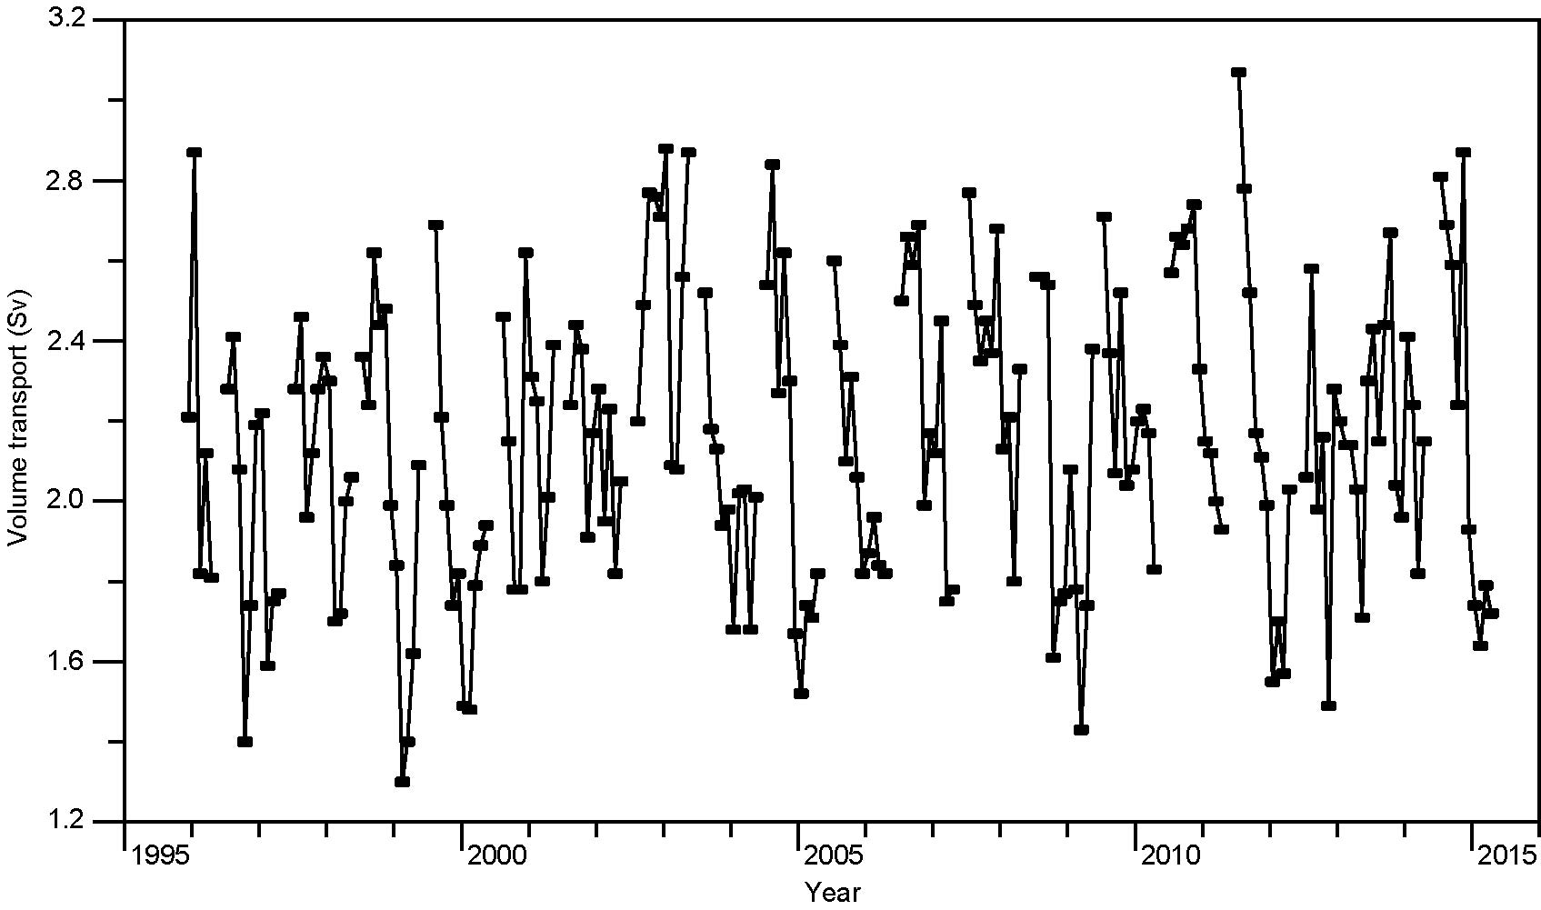
Faroe Bank Channel Overflow

Slide 28
Discussion
Practical implementation
Does OceanSITES want to support this?How can OceanSITES support this?
GDACs
What external support is necessary? The EU grant could pay for some personnel.
Direct access to data via external web site
  Which website?
  JCOMM? Atlantic Clivar? OceanSITES?

